Slide 1
Adaptive Integration for Simulations of Molecular Systems and Finite Element Analysis of Halbach Arrays for Superconducting Magnetic Levitation
A Dissertation
Christopher A. Mirabzadeh
University of Idaho

Slide 2
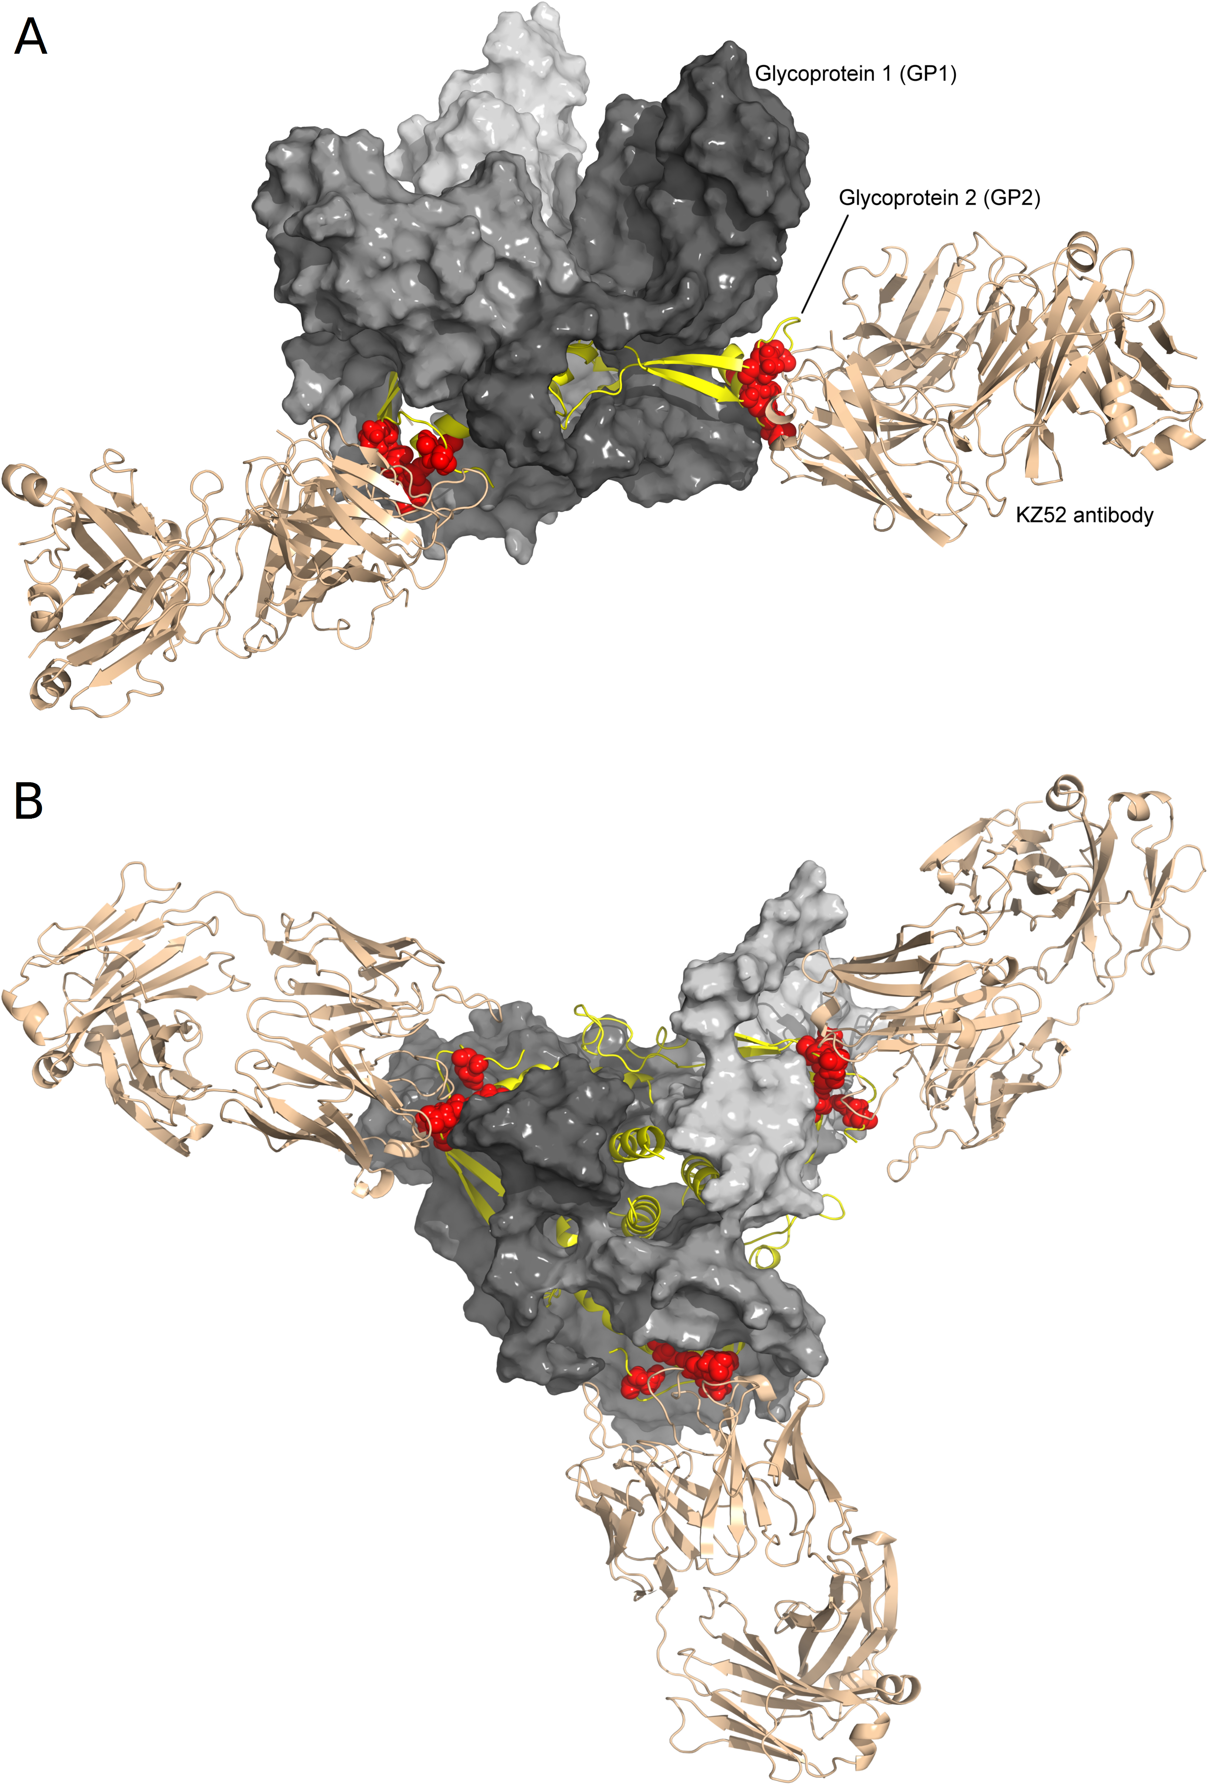
Ytreberg lab
Using molecular modeling to understand protein function and evolution
H. A. Wichman, T. A. Miura, F. M. Ytreberg, E. L. Johnson, A. Z. Burke, C. J. Brown, C. R. Miller, and K. P. Martin, “Initiating a watch list for Ebola virus antibody escape mutations,” PeerJ, vol. 4, e1674, 2016.
Structure of Ebola glycoprotein trimer in complex with the KZ52 antibody as viewed from the side (A) and the bottom (B). GP1 is in gray, GP2 is in yellow and the structure is after 10 ns of MD simulation. The six watch list sites that are predicted to contain antibody escape mutants are shown as red spheres and are all located in GP2.

Slide 3
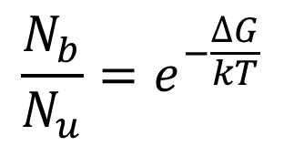
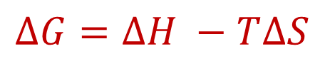
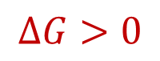
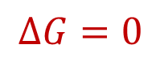
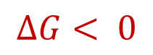
Free energy
$$∆G=∆H −T∆S$$
$$∆G< 0$$
$$\frac{N_{b}}{N_{u}}=e^{−\frac{∆G}{kT}}$$
What if?
$$∆G=0$$
$$∆G>0$$
Binding Affinity

Slide 4
﻿IMPLEMENTATION OF ADAPTIVE INTEGRATION METHOD FOR FREE ENERGY CALCULATIONS IN MOLECULAR SYSTEMS
Developing more efficient methods for calculating free energies in molecular systems and using them to understand protein evolution.
Specifically, implementing the Monte Carlo adaptive integration method for use in the larger simulation package, GROMACS.
Goal:
Show that AIM is more efficient than standard methods for simple test cases, that is, AIM results converge to a higher level of accuracy and precision for a given simulation time.
Validate by comparing results from AIM to those from a suite of standard methods.
Test against simple model systems
Solvation free energy of methane, and the
Free energy of mutating the peptide GAG to GVG.

Slide 5
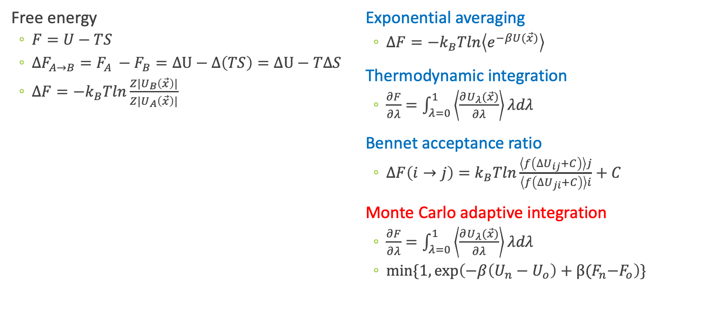
Free energy methods
Free energy
$F=U−TS$
$∆F_{A→B}=F_{A }−F_{B}=∆U−∆\left(TS\right)=∆U−T∆S$
$∆F=−k_{B}Tln\frac{Z|U_{B}\left(\vec{x}\right)|}{Z|U_{A}\left(\vec{x}\right)|}$
Exponential averaging
$∆F=−k_{B}Tln\left\langle e^{−βU(\vec{x})}\right\rangle$
Thermodynamic integration
$\frac{∂F}{∂λ}=\int_{λ=0}^{1}{\left\langle \frac{∂U_{λ}(\vec{x})}{∂λ}\right\rangle λdλ}$
Bennet acceptance ratio
$∆F\left(i→j\right)=k_{B}Tln\frac{\left\langle f\left({∆U}_{ij}+C\right)\right\rangle j}{\left\langle f\left({∆U}_{ji}+C\right)\right\rangle i}+C$
Monte Carlo adaptive integration
$\frac{∂F}{∂λ}=\int_{λ=0}^{1}{\left\langle \frac{∂U_{λ}(\vec{x})}{∂λ}\right\rangle λdλ}$
$min⁡\{1,\exp\left(−β\left(U_{n}−U_{o}\right)+β{(F}_{n}−F_{o}\right)\}$

Slide 6
Monte Carlo methods
In molecular simulations, ‘Monte Carlo’ is an importance sampling technique
Make random move and produce a new conformation
Calculate the energy change ΔE for the new conformation
Accept or reject the move based on the Metropolis criterion
Ratio of the Boltzmann factors between two states

Slide 7
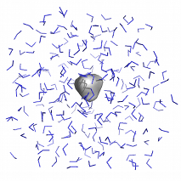
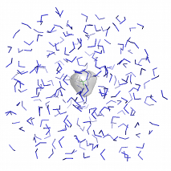
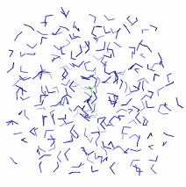
Test cases
Methane solvation free energy
λ = 0
λ = 0.5
λ = 1
Image reference: http://www.mdtutorials.com/gmx/free_energy/03_workflow.html
GAG to GVG Mutation free energy

Slide 8
Alchemical molecular dynamics
Standard methods
using Fixed λ states
Estimate after
100
100
100
100
100
100
100
A
B
Intermediate λ states
Monte Carlo AIM
Estimate during
65
87
100
113
135
144
56
A
B

Slide 9
Methane solvation free energy
Methane solvation free energy results. Eight trial simulations of 100 ps per λ for 11, 21 and 31 λ values. This shows how the number of λ values were chosen to effectively compare AIM to fixed λ simulations. The circles indicate the region where the λ density needed to be increased

Slide 10
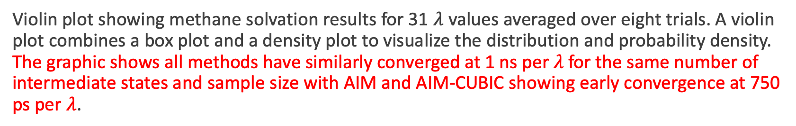
Methane solvation free energy
Violin plot showing methane solvation results for 31 $λ$ values averaged over eight trials. A violin plot combines a box plot and a density plot to visualize the distribution and probability density. The graphic shows all methods have similarly converged at 1 ns per $λ$ for the same number of intermediate states and sample size with AIM and AIM-CUBIC showing early convergence at 750 ps per $λ$.

Slide 11
Alanine to valine mutation
Alanine to valine mutation free energy. Eight trial simulations of 41 λ values at 1 ps, 100 ps and 1 ns per λ. Note the smoothness of AIM versus fixed λ simulations. AIM requires less samples than fixed λ simulations to smooth the free energy function.

Slide 12
Alanine to valine mutation
Violin plot showing alanine to valine mutation results for 41 λ values averaged over eight trials. The graphic shows all methods have similarly converged at 1 ns per λ. Note that AIM and AIM-CUBIC converge more rapidly than other methods and are mostly converged at 100 ps per λ.

Slide 13
Discussion
The problem of free energy estimation can be broken into three parts:
What reference and (possibly) intermediates to use;
What transition algorithms to use for sampling the ensembles; and
How best to estimate the free energy from the resulting data.

Slide 14
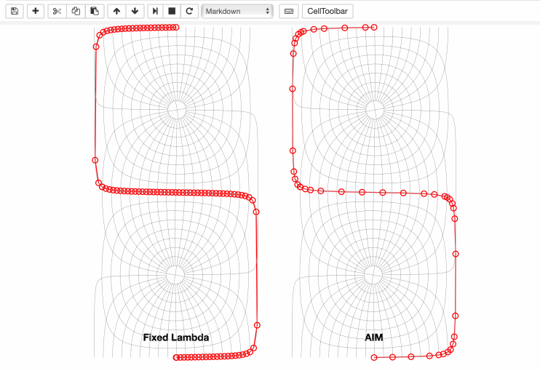
Fixed versus adaptive

Slide 15
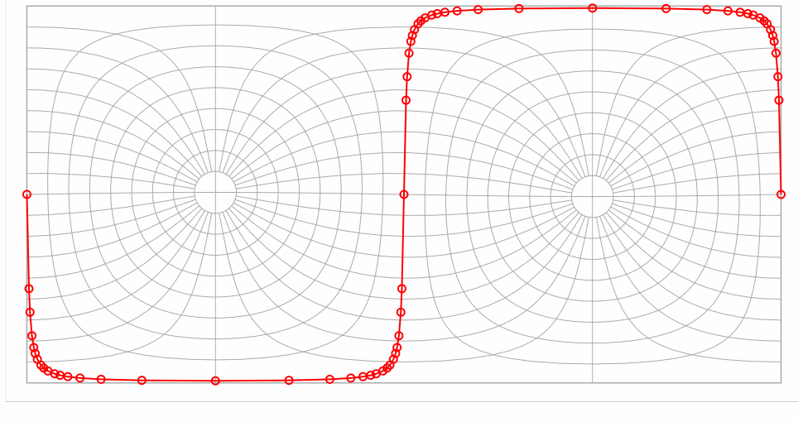
Intermediate steps

Slide 16
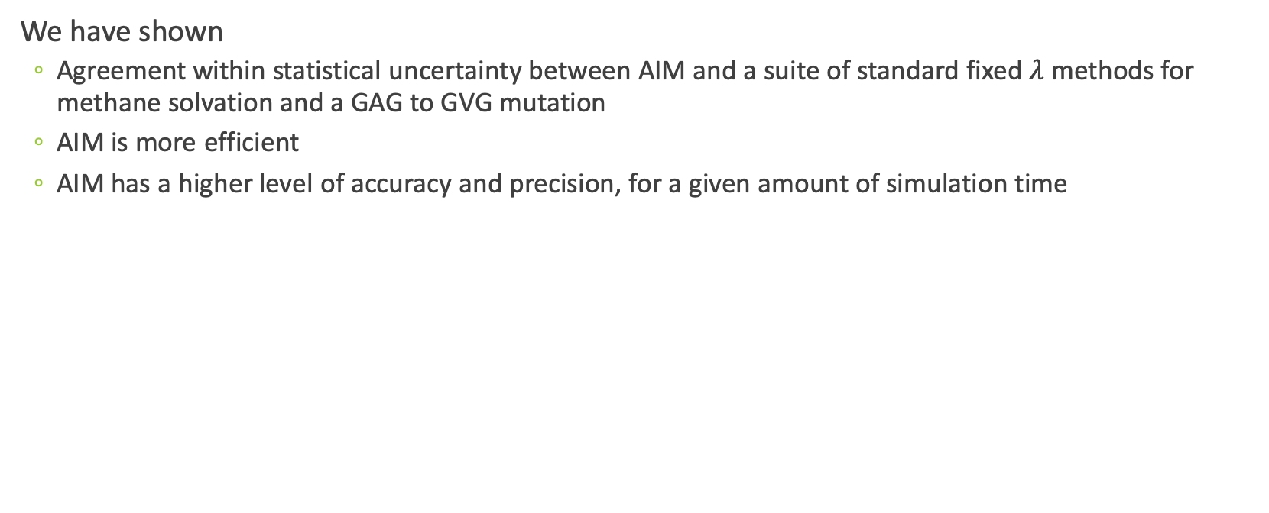
Conclusion
We have shown
Agreement within statistical uncertainty between AIM and a suite of standard fixed $λ$ methods for methane solvation and a GAG to GVG mutation
AIM is more efficient
AIM has a higher level of accuracy and precision, for a given amount of simulation time

Slide 17
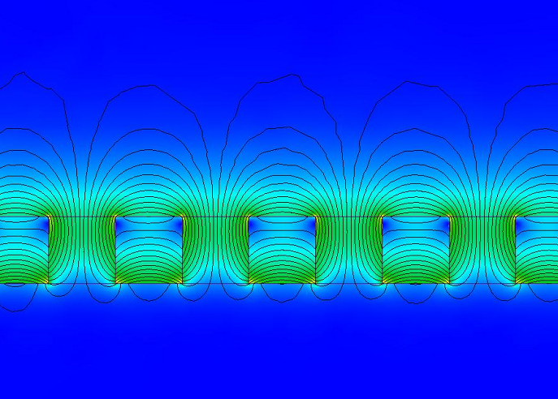
Design Considerations for Implementing Halbach Arrays and High Temperature Superconductors for Contact-Free Flywheel Energy Storage Systems
Goal:
Understand and optimize use of Halbach magnet arrays with Superconductors in a contact-less thrust bearing for a Flywheel Energy Storage System
An infinitely repeating array of magnets called a Halbach Array. The black lines are the flux lines and the gradient colors represent the magnetic field. The arrows represent the direction of the magnetic field.

Slide 18
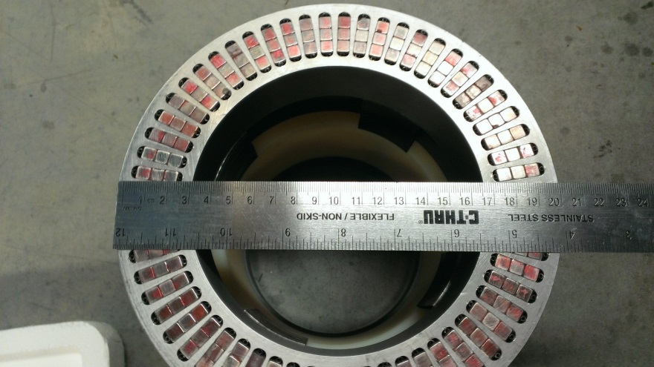
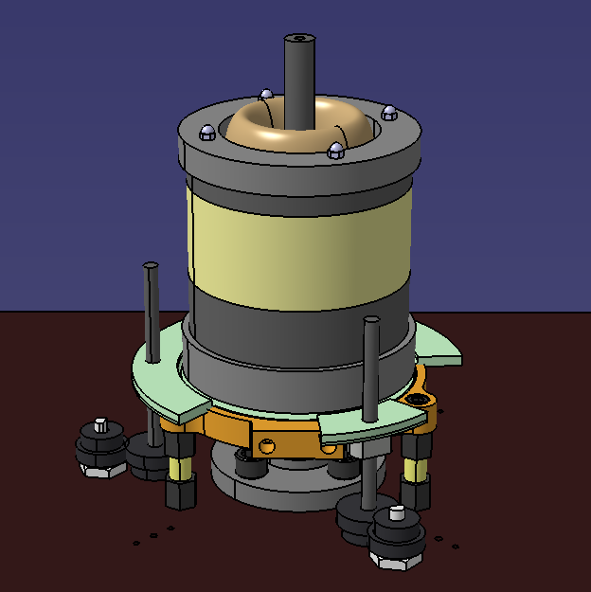
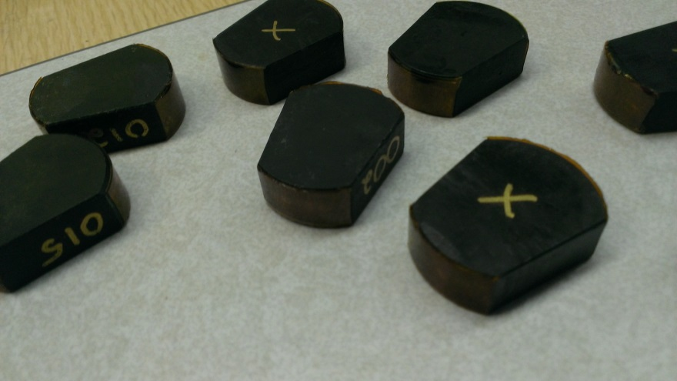
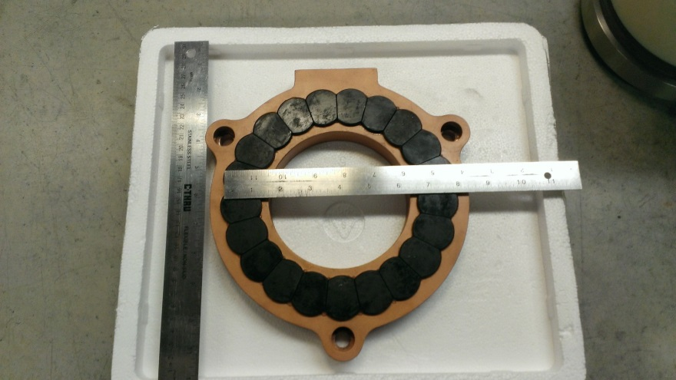
Flywheel Energy Storage
Combined Flywheel/Field Regulated Reluctance Motor/Generator
Spinning Flywheel (Stores Kinetic Energy)
Magnet-Superconductor Levitation System (Minimizes Frictional Losses)

Slide 19
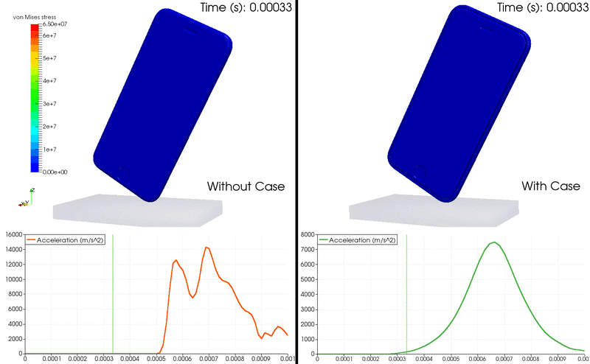
Finite element analysis simulations
iPhone drop FEA Simulation
with SimScale
https://www.simscale.com/docs/_images/iPhoneWithAndWihoutCover.gif

Slide 20
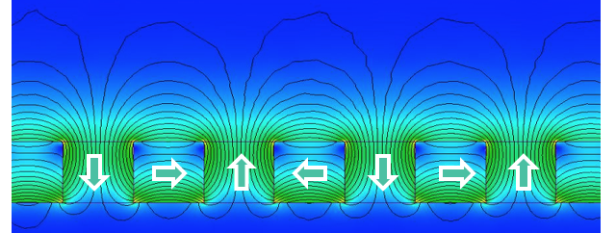
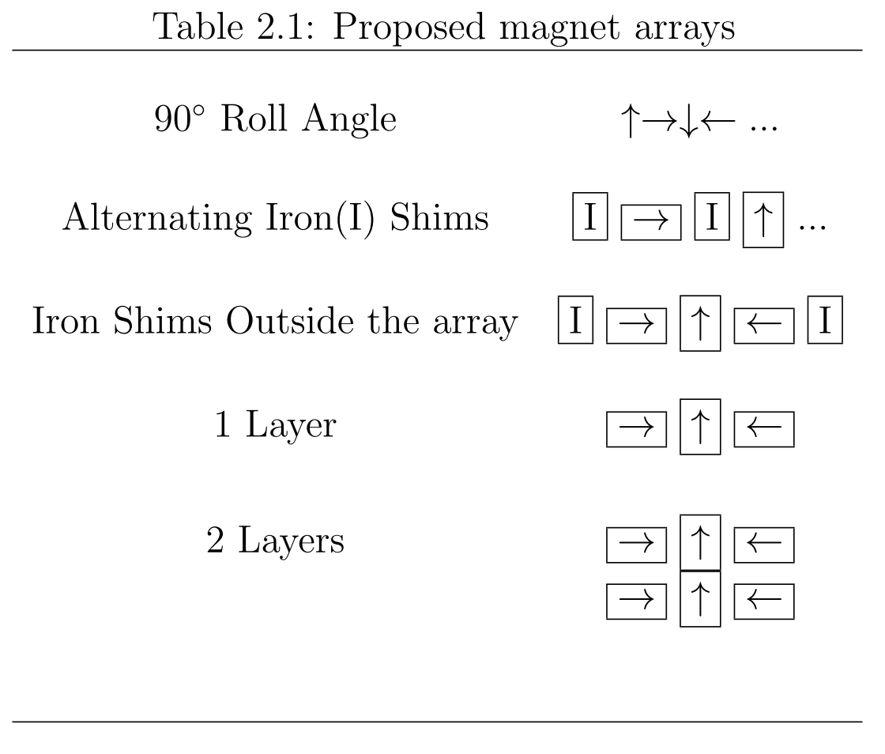
Levitating Halbach system
Shows
Increased levitation force
Increased bearing stiffness
Enhanced stability
On average, 2.3 times stronger than a single permanent magnet of the same volume

Slide 21
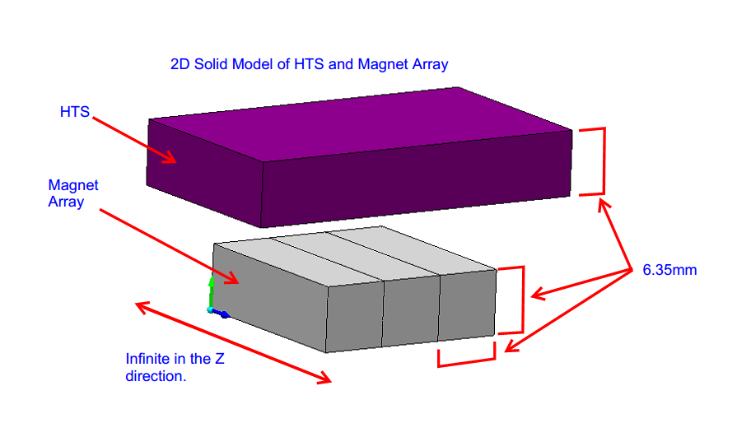
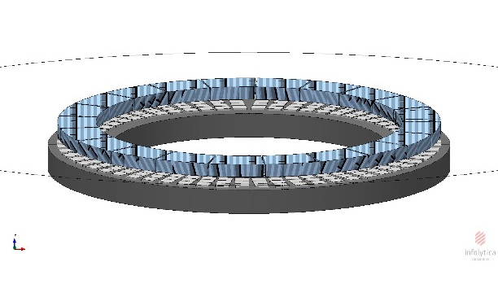
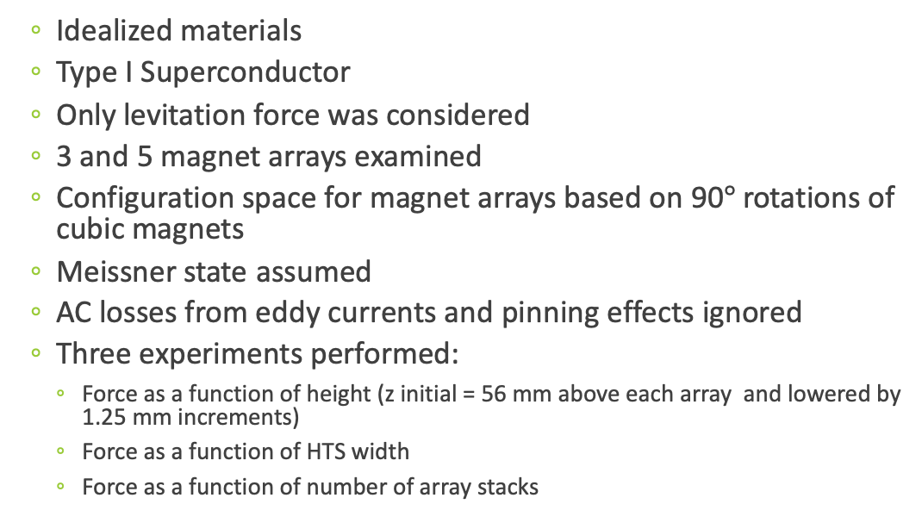
Computational
Idealized materials
Type I Superconductor
Only levitation force was considered
3 and 5 magnet arrays examined
Configuration space for magnet arrays based on 90$°$ rotations of cubic magnets
Meissner state assumed
AC losses from eddy currents and pinning effects ignored
Three experiments performed:
Force as a function of height (z initial = 56 mm above each array and lowered by 1.25 mm increments)
Force as a function of HTS width
Force as a function of number of array stacks

Slide 22
Data Reduction Rules
In order to reduce stray fields and maintain one-sided flux only periodic arrays similar to Halbach arrays were considered.
Profiles with degenerate solutions were deemed unnecessary and discarded.
Through consideration of project constraints it was determined that 3 magnets in two stacks would be sufficient to supply the needed force.
It was decided that a potential well of magnetic flux would add some stability.
The software for modeling the levitation forces, although only able to model an idealized situation, can give useful information regarding the prediction of the levitation forces.

Slide 23
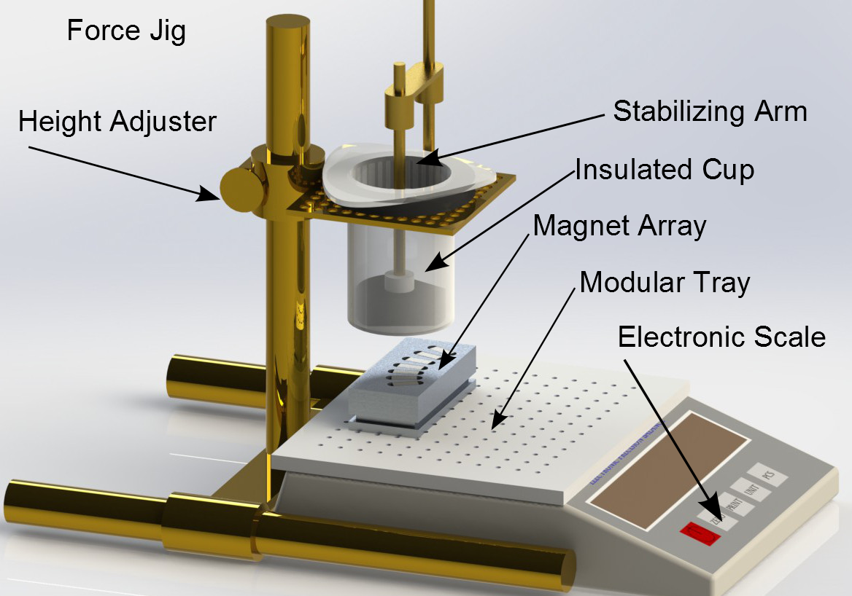
Experimental
HTS sample secured in a plastic cup by a stabilizing rod
Magnet block centered on the modular tray below the cup holder
Cup with superconductor was cooled "infinitely” far from the force jig. (at least 32 cm away)
Initial starting height of 56 mm
Lowered in 1.25 mm (0.05 in.) increments
At each increment the scale was read and the force recorded
Repeated in reverse to observe any hysteresis

Slide 24
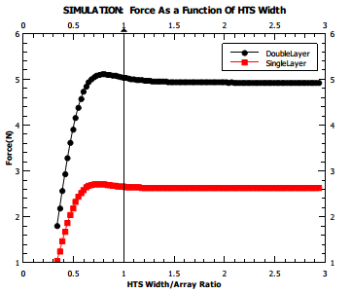
Width ratio?
When considering more stable configurations, width ratios greater than 1.3:1 for superconductor to magnet array size shows no considerable reduction in levitation force.

Slide 25
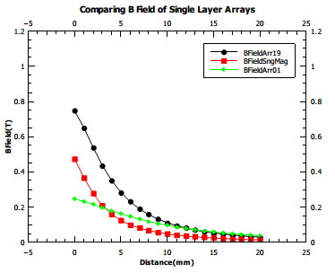
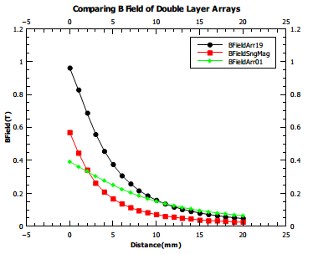
One or two layers?
The optimum configuration for a 3-magnet Halbach consisting of cube magnets is the configuration in two layers
The concentration of flux is symmetric
The total area of flux seen by the HTS is maximized

Slide 26
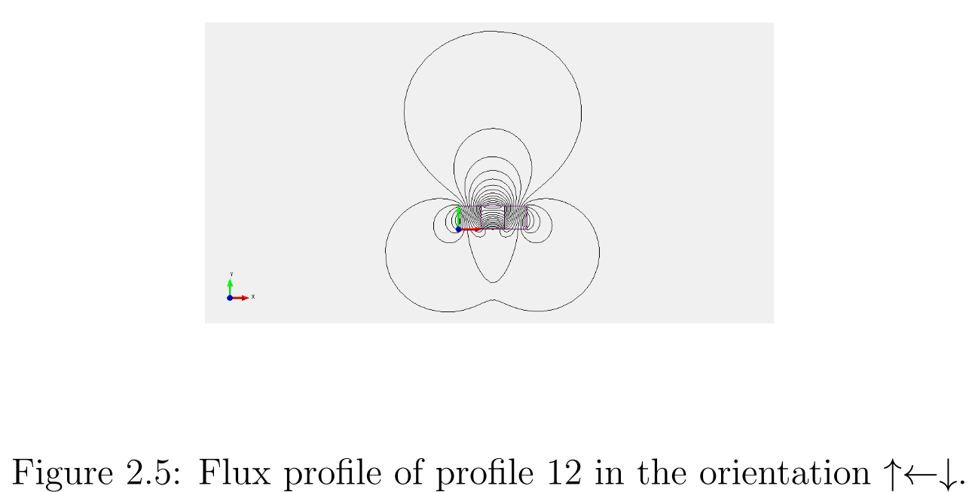
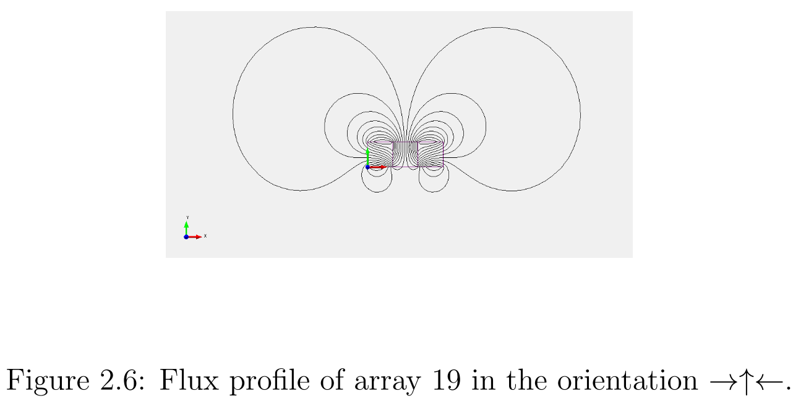
Contenders
﻿The configurations that best met the criteria were profiles 12 and 19.
Profile 12 was rejected due to smaller force profile and lacked the desired flux geometry.
Profile 19 was found to meet the minimum fit for all arguments of space, volume, force and stability.

Slide 27
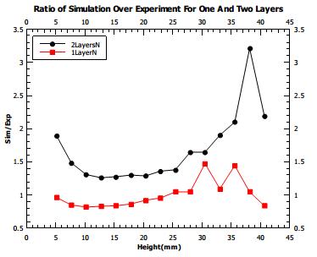
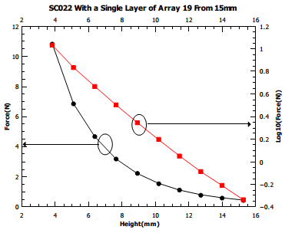
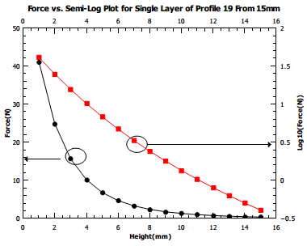
Comparing Computational to Experimental
Computational
As expected the computational model overestimates the levitation force uniformly over a wide range of levitation heights
Experimental

Slide 28
Conclusion
Simulation software can be used for initial design evaluation although the results will overestimate the levitation forces
The Halbach array focuses flux, allows for flux control, increases the flux gradient, and increases levitation stiffness
More than two layers of magnets result in only a small increase in overall levitation force and therefore the increased volume and mass of the magnets would likely be of negligible benefit
The decrease in levitation force over time caused by flux creep is expected to be minimized by either pre-loading the flywheel before initial rotation or by cooling HTS in presence of magnetic flux
Pre-loading and field-cooling allows the HTS to better resist any changes in the external magnetic field

Slide 29
